Slide 1
Wireless Propagation
Wireless propagation is the movement of these radio waves (which move at the speed of light) to and from these sites and devices.

Slide 2
Wireless Propagation Modes:
Ground Wave Propagation
Sky Wave Propagation
Line-of-Sight Propagation

Slide 3
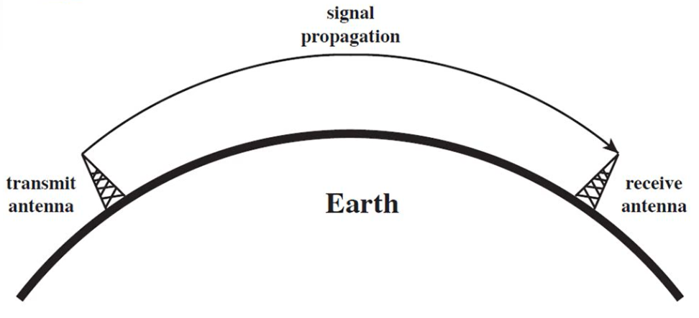
Ground Wave Propagation
Follows contour of the earth.
Can propagate considerable distances.
Frequency up to 2 MHz.
Example: AM radio broadcasting.

Slide 4
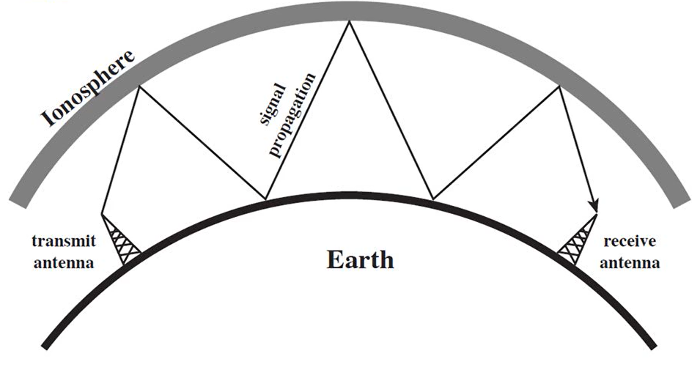
Sky Wave Propagation
Signal reflected from ionized layer of atmosphere back to earth.
Frequency between 2 to 30 MHz.
Example: Amateur radio, military communication.

Slide 5
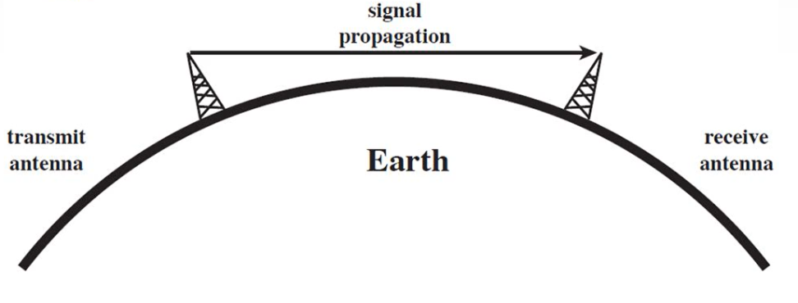
Line-of-Sight Propagation
Requires the transmitting and receiving antennas to be within the line of sight of each other.
Frequency above 30 MHz.
Example: FM broadcast.

Slide 6
Line-of-Sight Equation
With no intervening obstacles, the optical line of sight can be expressed as
d = 3.57 √h
Where
d = distance between antenna and the horizon(Km)
h = height of antenna(m)

Slide 7
Wireless Propagation Characteristics
Path Loss
Shadowing
Multipath Fading

Slide 8
Path Loss
Path loss (PL) refers to the loss or attenuation a propagating electromagnetic signal (or wave) encounters along its path from transmitter to the receiver.
The received power level is dependent on factors such as transmission power, antenna gains, frequency of operation and the distance between the transmitter and the receiver.

Slide 9
Shadowing
Shadowing is caused by obstacles between the transmitter and receiver that attenuate signal power through absorption, reflection, scattering, and diffraction.

Slide 10
Multipath fading
In multipath propagation, multiple signal paths are established between the base station and the user terminal. The fading due to multipath propagation is known as Multipath fading.

Slide 11
